Slide 1

CHAPTER 10
GRAPHS AND TREES
Copyright © Cengage Learning. All rights reserved.

Slide 2
SECTION 10.4
Isomorphisms of Graphs
Copyright © Cengage Learning. All rights reserved.

Slide 3
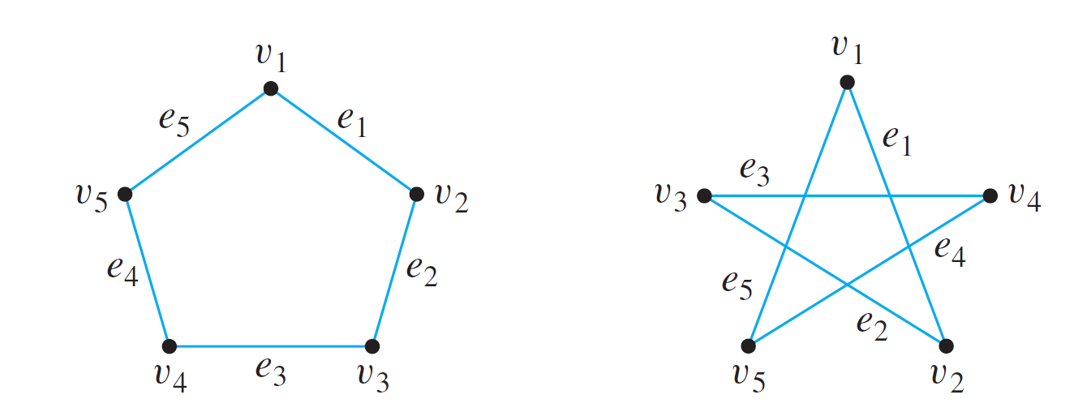
Isomorphisms of Graphs
The two drawings shown in Figure 10.4.1 both represent the same graph: Their vertex and edge sets are identical, and their edge-endpoint functions are the same. Call this graph G.
Figure 10.4.1

Slide 4
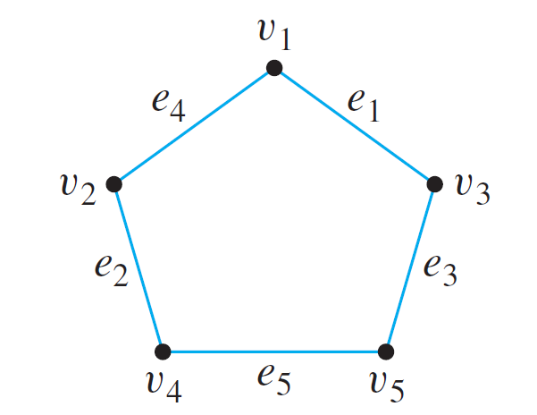
Isomorphisms of Graphs
Now consider the graph G′ represented in Figure 10.4.2.
Observe that G′ is a different graph from G (for instance, in G the endpoints of e₁ are v₁ and v₂, whereas in G′ the endpoints of e₁ are v₁ and v₃).
Figure 10.4.2

Slide 5
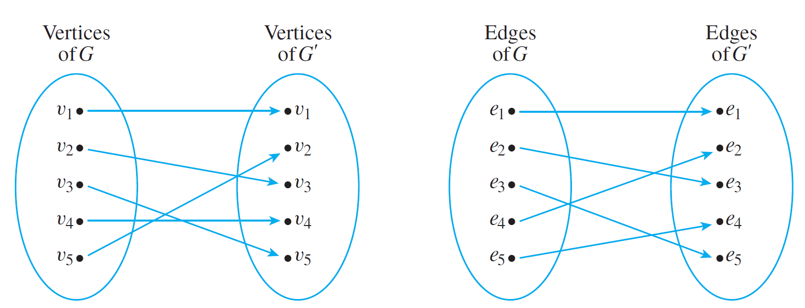
Isomorphisms of Graphs
Yet G′ is certainly very similar to G. In fact, if the vertices and edges of G′ are relabeled by the functions shown in Figure 10.4.3, then G′ becomes the same as G.
Note that these relabeling functions are one-to-one and onto.
Figure 10.4.3

Slide 6
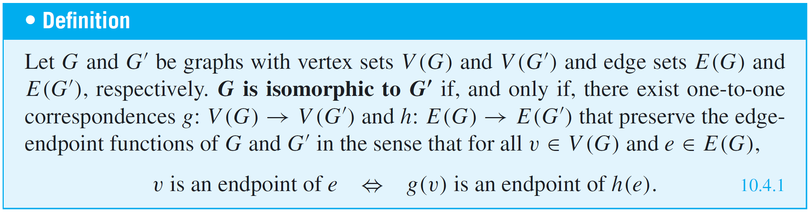
Isomorphisms of Graphs
Two graphs that are the same except for the labeling of their vertices and edges are called isomorphic.
The word isomorphism comes from the Greek, meaning “same form.” Isomorphic graphs are those that have essentially the same form.

Slide 7
Isomorphisms of Graphs
In words, G is isomorphic to G′ if, and only if, the vertices and edges of G and G′ can be matched up by one-to-one, onto functions such that the edges between corresponding vertices correspond to each other.
It is common in mathematics to identify objects that are isomorphic.
For instance, if we are given a graph G with five vertices such that each pair of vertices is connected by an edge, then we may identify G with K₅, saying that G is K₅ rather than that G is isomorphic to K₅.

Slide 8
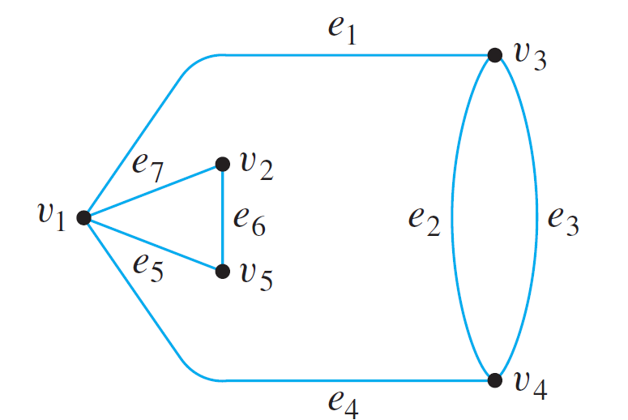
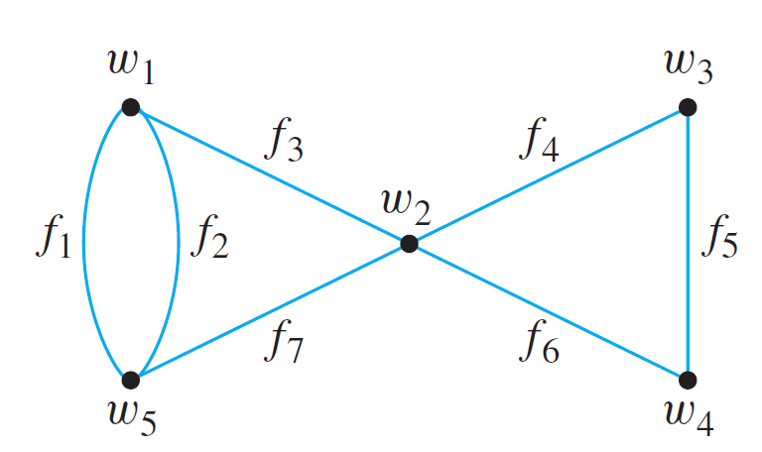
Example 1 – Showing That Two Graphs Are Isomorphic
Show that the following two graphs are isomorphic.
Solution:
To solve this problem, you must find functions g: V(G) → V(G′) and h: E(G) → E(G′) such that for all
v ∈ V(G) and e ∈ E(G), v is an endpoint of e if, and only if, g(v) is an endpoint of h(e).
G
G'

Slide 9
Example 1 – Solution
cont’d
Setting up such functions is partly a matter of trial and error and partly a matter of deduction.
For instance, since e₂ and e₃ are parallel (have the same endpoints), h(e₂) and h(e₃) must be parallel also.
So h(e₂) = f₁ and h(e₃) = f₂ or h(e₂) = f₂ and h(e₃) = f₁.
Also, the endpoints of e₂ and e₃ must correspond to the endpoints of f₁ and f₂, and so g(v₃) = w₁ and g(v₄) = w₅ or g(v₃) = w₅ and g(v₄) = w₁.

Slide 10
Example 1 – Solution
cont’d
Similarly, since v₁ is the endpoint of four distinct edges (e₁, e₇, e₅, and e₄), g(v₁) must also be the endpoint of four distinct edges (because every edge incident on g(v₁) is the image under h of an edge incident on v₁ and h is one-to-one and onto).
But the only vertex in G′ that has four edges coming out of it is w₂, and so g(v₁) = w₂.
Now if g(v₃) = w₁, then since v₁ and v₃ are endpoints of e₁ in G, g(v₁) = w₂ and g(v₃) = w₁ must be endpoints of h(e₁) in G′. This implies that h(e₁) = f₃.

Slide 11
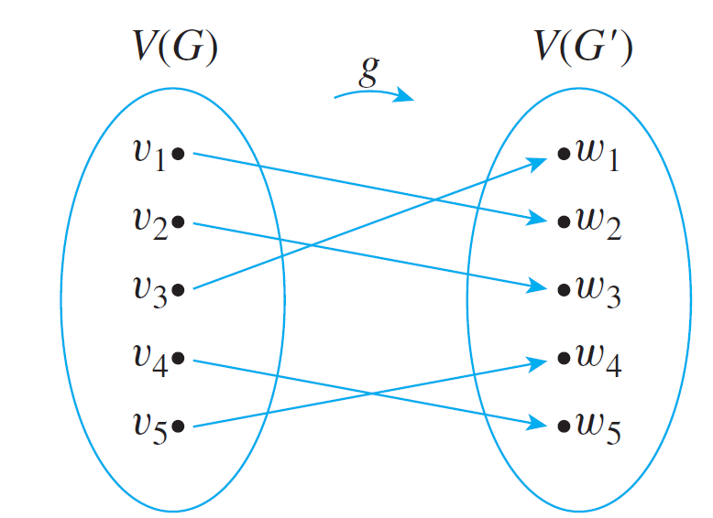
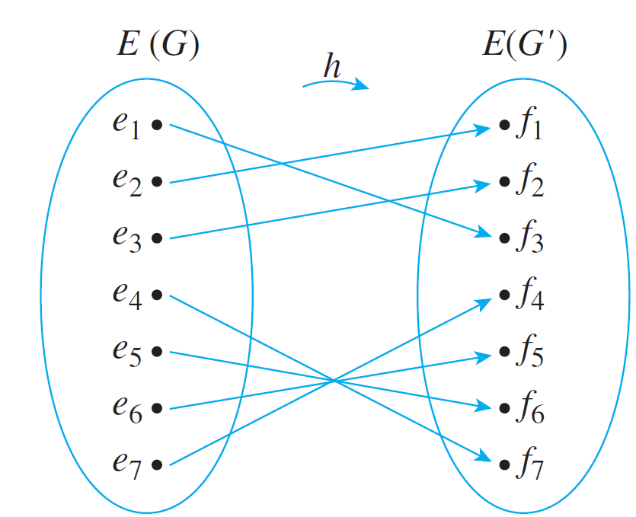
Example 1 – Solution
cont’d
By continuing in this way, possibly making some arbitrary choices as you go, you eventually can find functions g and h to define the isomorphism between G and G′.
One pair of functions (there are several) is the following:

Slide 12
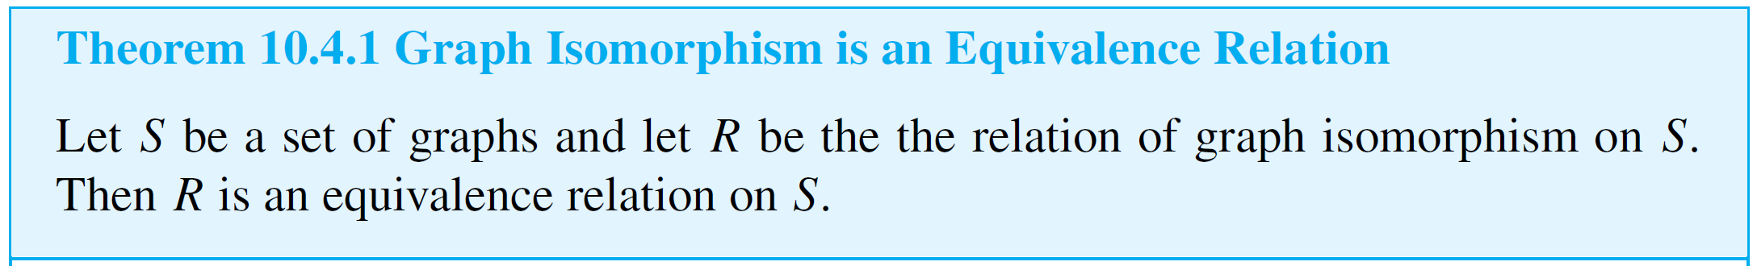
Isomorphisms of Graphs
It is not hard to show that graph isomorphism is an equivalence relation on a set of graphs; in other words, it is reflexive, symmetric, and transitive.
Now consider the question, “Is there a general method to figure out whether graphs G and G′ are isomorphic?”
In other words, is there some algorithm that will accept graphs G and G′ as input and produce a statement as to whether they are isomorphic?

Slide 13
Isomorphisms of Graphs
In fact, there is such an algorithm. It consists of generating all one-to-one, onto functions from the set of vertices of G to the set of vertices of G′ and from the set of edges of G to the set of edges of G′ and checking each pair to determine whether it preserves the edge-endpoint functions of G and G′.
The problem with this algorithm is that it takes an unreasonably long time to perform, even on a high-speed computer.

Slide 14
Isomorphisms of Graphs
If G and G′ each have n vertices and m edges, the number of one-to-one correspondences from vertices to vertices is n! and the number of one-to-one correspondences from edges to edges is m!, so the total number of pairs of functions to check is n!  m!.
For instance, if m = n = 20, there would be
20!  20! ≅ 5.9 × 10³⁶ pairs to check.
Assuming that each check takes just 1 nanosecond, the total time would be approximately 1.9 × 10²⁰ years!

Slide 15
Isomorphisms of Graphs
Unfortunately, there is no more efficient general method known for checking whether two graphs are isomorphic. However, there are some simple tests that can be used to show that certain pairs of graphs are not isomorphic.
For instance, if two graphs are isomorphic, then they have the same number of vertices (because there is a one-to-one correspondence from the vertex set of one graph to the vertex set of the other).
It follows that if you are given two graphs, one with 16 vertices and the other with 17, you can immediately conclude that the two are not isomorphic.

Slide 16
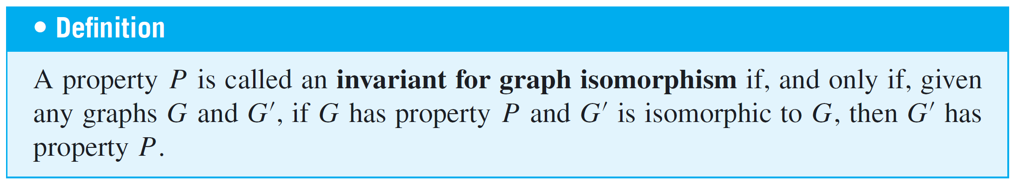
Isomorphisms of Graphs
More generally, a property that is preserved by graph isomorphism is called an isomorphic invariant.
For instance, “having 16 vertices” is an isomorphic invariant: If one graph has 16 vertices, then so does any graph that is isomorphic to it.

Slide 17
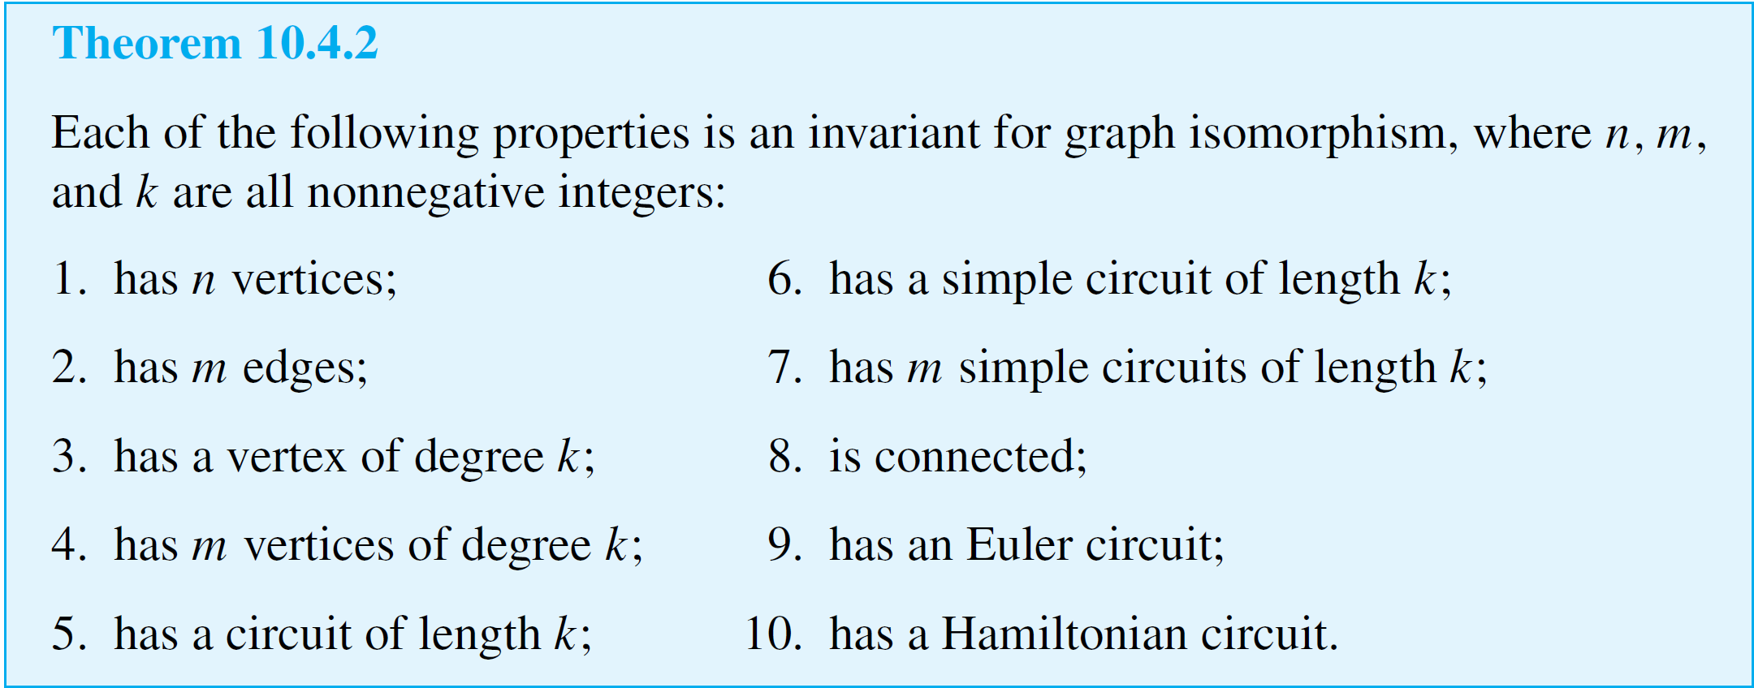
Isomorphisms of Graphs

Slide 18
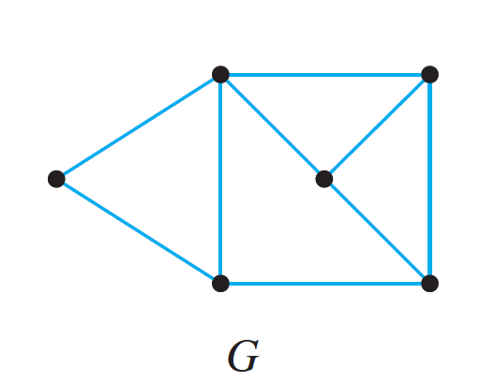
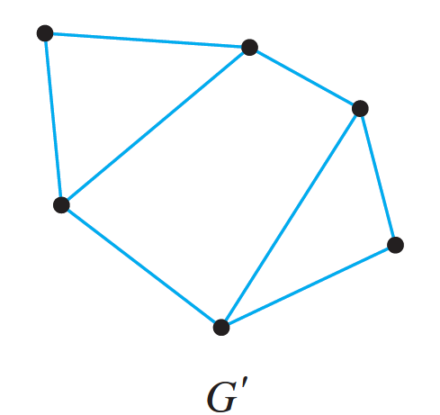
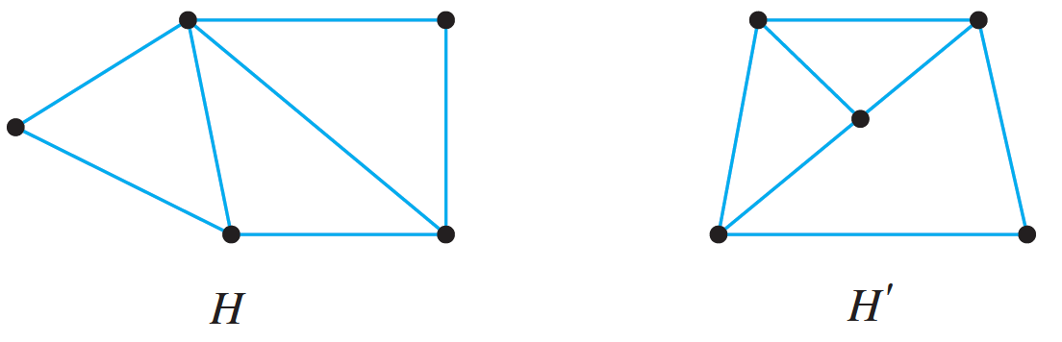
Example 3 – Showing That Two Graph Are Not Isomorphic
Show that the following pairs of graphs are not isomorphic by finding an isomorphic invariant that they do not share.
a.
b.

Slide 19
Example 3 – Solution
a. G has nine edges; G′ has only eight.
b. H has a vertex of degree 4; H′ does not.

Slide 20
Graph Isomorphism for Simple Graphs

Slide 21
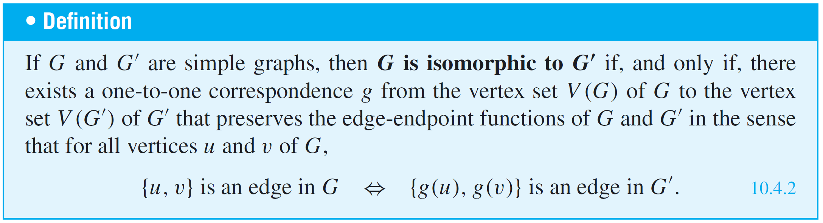
Graph Isomorphism for Simple Graphs
When graphs G and G′ are both simple, the definition of G being isomorphic to G′ can be written without referring to the correspondence between the edges of G and the edges
of G′.

Slide 22
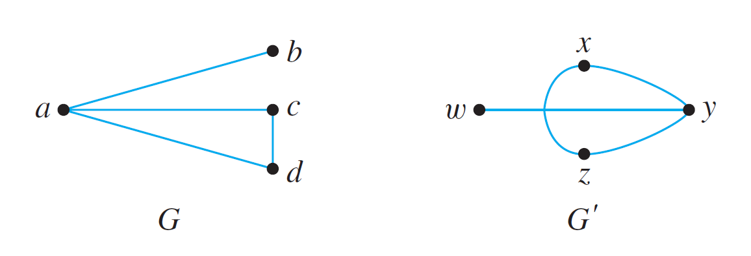
Example 5 – Isomorphism of Simple Graphs
Are the two graphs shown below isomorphic? If so, define an isomorphism.

Slide 23
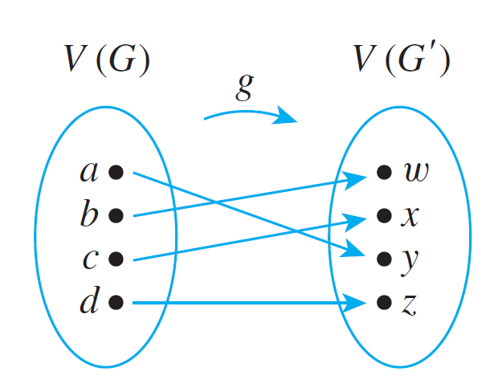
Example 5 – Solution
Yes. Define f : V(G) → V(G′) by the arrow diagram shown below.
Then g is one-to-one and onto by inspection.

Slide 24
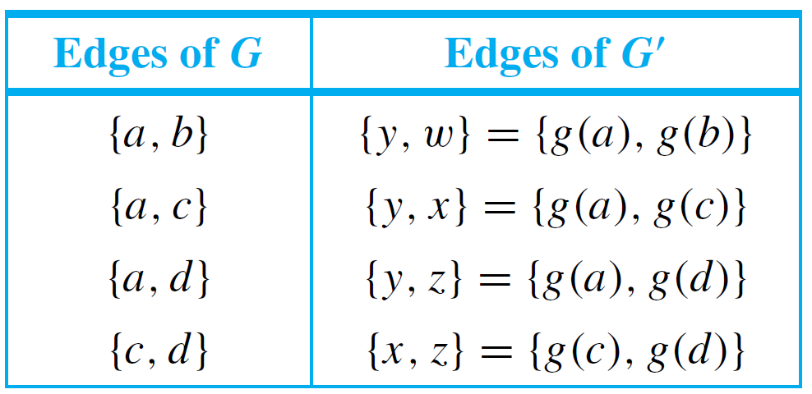
Example 5 – Solution
cont’d
The fact that g preserves the edge-endpoint functions of G and G′ is shown by the following table:

